Slide 1
Title of the project
Under guidance of
Mr/Dr. PRABU V,
PROFESSOR,
BIT,
Sathy.
Student 1 (191BM131 & PREM M)
Student 2 (191BM144 & SIVA SAMBATH K)
Student 3 (191BM142 & SHAM V)

Slide 2
Abstract
Our World is worried about these Pandemic Situations. We should fight against this truculent virus because the probability of mortality rate in our world is rapidly increasing so we people have paved a path of telehealth care communication for CVD(Cardiovascular Disease) patients. Our New Innovation concerns rural area patients with the help of doctors.Our current situation at home is better than a hospital visit. So what only we people introduce telehealth communication also. By the use of digital phonocardiogram devices, Doctors can easily get your recorded heart sounds from cloud computing and visualise the phonocardiogram data using the mobile application to diagnose the problem.
Cardiovascular Disease is a type of heart illness majorly it affects our heart and blood vessels in our body. So the heart sounds like endangered murmurs and unnecessary noise. Through reckoning, we introduce a sophisticated new innovation Phonocardiogram for instant diagnosis. Phonocardiogram is an advanced technology. Acoustic or traditional stethoscope is only for auscultation or listening to the heart sounds. In the Rudimentary of traditional or acoustics stethoscopes there is a doctor or nurse only able to use it. Because they can only ensure to check heart beats and pulse rate.

Slide 3
Problem Statement Addressed
Among these factors, 13% of the mortality rate is accounted due to hypertension, 9% is accounted by tobacco, 6% is by diabetes, 6 % is by obesity and 5% is by lack of exercise. Auscultation of CV system allows us to aid even the valvular heart disease (VHD), hypertensive disease and congestive heart failure.
Major heart diseases could be diagnosed initially through the auscultation in the pulmonary pathology, so it is prevailed to diagnose the pulmonary pathology to procure the accurate diagnosis. The perceptiveness of auscultation is through the vibration engendered in the heart at the frequency rate of (20-20,000Hz) during the cardiac cycle.
There are sundry devices for diagnosing the cardiac disease such as ECG (Electro Cardio Gram), C MRI (Cardiac Magnetic Resonance Imaging), CT (Computed Tomography).
The basis for CVD are lack of exercise, smoking, consumption of alcohol, anxiety, hypertension, obesity, high cholesterol level in the food items etc .
Cardiovascular disease is a type of disease that is related to heart and blood vessels. The symptoms for the utmost heart disease is vicissitude in the heart sounds and engendered murmurs in the heart.Through reckoning, it has been delineated that 85 % of the CVD are preventable .

Slide 4
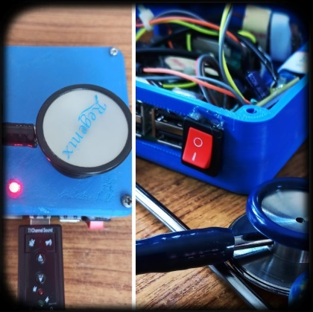
Existing Solution to the Problem Addressed
In the absence of the doctor, the patient could directly record the sound of the heart and save it in the form of .wav file through raspberry pi. The recorded data is sent through IoT to the doctor and gets stored in the cloud computing. Now the doctor on the other side could hear the heart sound and visualise the phonocardiogram using the mobile application (SMART HEALTHCARE) to diagnose the problem.

Slide 5
Proposed Solution to the Problem Addressed
The digital stethoscope helps in the conversion of an acoustic sound into electrical signals, which can be later amplified or tuned to get an optimal listening. Later these signals could be transmitted to the personal computer or laptop.
Traditional system needs a doctor or nurse to ensure with the heart beats and Pulse rate. Since the Pulse rate, sound levels and the opening and closure of the auricle and ventricle valves can only get diagnose by doctors. But the digital stethoscope has paved a path for the patients to be independent on the doctors or nurses to diagnose their problems.
The digital stethoscope consists of three phase, data procurement, amplification and signal processing. The data procurement is done through the diaphragm and the condenser microphone. During the amplification process, the pre-amplifier removes the external noise (environmental noises) and transfer only the sound engendered from the heart. At signal processing, the recorded sound is transmitted to the personal computer or the mobile phone as .wav File, such that the subject can view or listen the audio whenever needed.

Slide 6
The raspberry pi is used as a mini desktop computer. Raspberry pi is connected with a HDMI cable, a micro SD card, USB cable, keyboard, mouse and an TFT display. Nowadays the raspberry pi has inbuilt wifi and bluetooth facilities.
. The doctors at the other end now, can visualize the heart beats , hear the auscultation and determines the pulse rate remotely through mobile/web application by means of Internet of Things (IoT), So that the doctors can visit the patients once in a week and concern towards patients regularly. Henceforth the above proposed method can provide us solutions for Lack of remote access to medical care of Rural Population, Shortage of trained personnel, Expensive and complex equipment.

Slide 7
Project Work Plan
Moreover a graphical representation is engendered according to the recorded frequency .The microphone acts as a transducer, which converts the sound signals into electrical ones. The diaphragm in the stethoscope detects the heart sound and transmits it to the microphone. The diaphragm in the microphone receives the acoustic sound and creates a phonocardiogram according to the frequency range.
Since the sound travels between two diaphragms, there is air path between it and the output sound signal obtained from it gets aggregated with the external noise. Another transducer used in the device is the capacitor. The electrical signal is also engendered according to the change in the capacitance. There are assorted frequency modes in the digital stethoscope enabling the listener to hear the sounds from heart, lungs and other parts of the body.
The distinct features of the digital stethoscope are amplification, noise reduction, record the data, broadcast through the speakers, visualise the phonocardiogram and transmit the data. The capacitive transducer enables us to amplify the sound up to 10 times than the original sound. In order to hear the sound of lungs, the frequency must be set from 350Hz to 1900Hz. The amplifier extracts the ambient sound by enhancing the heart sound

Slide 8
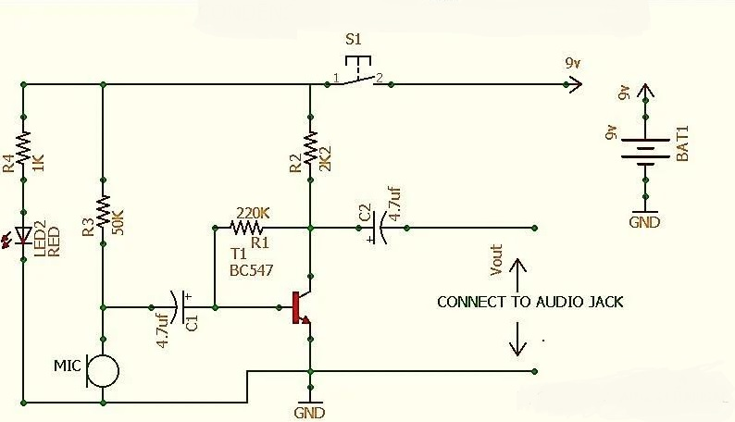
Block Diagram and/or Circuit Diagram

Slide 9
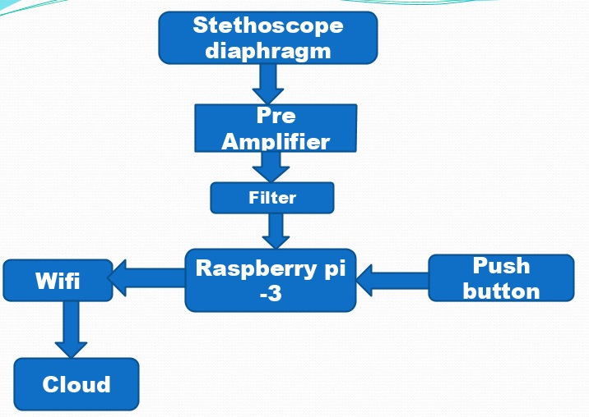
Flow Chart

Slide 10

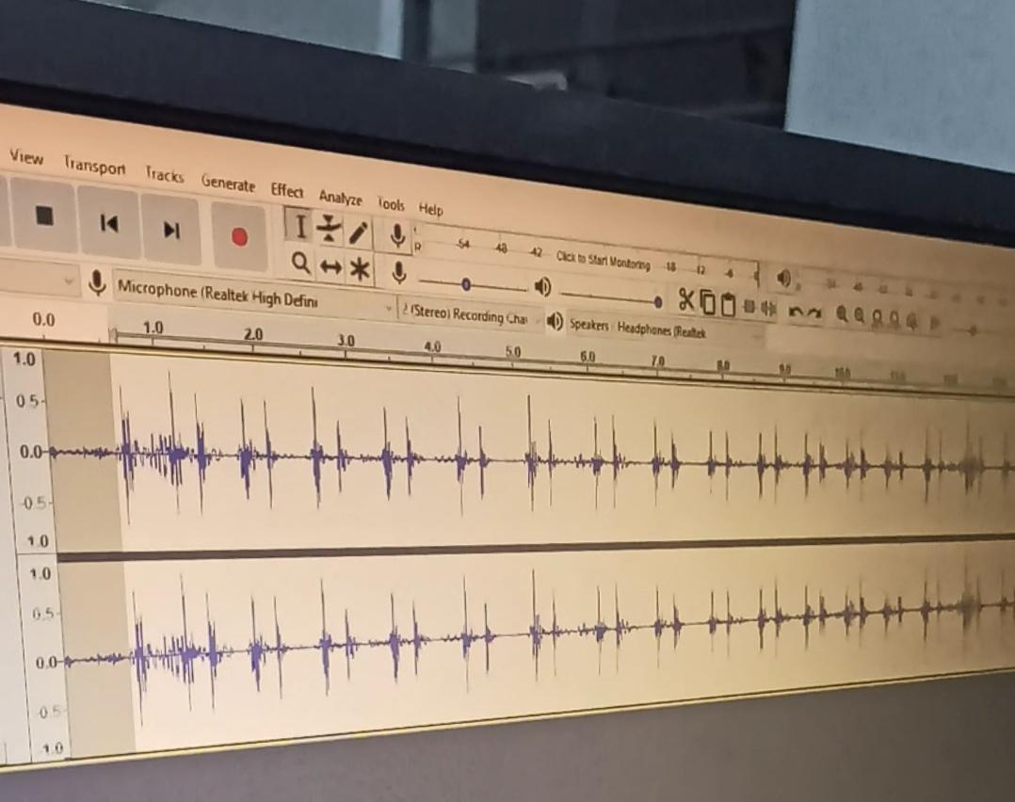
Prototype & Sample Output

Slide 11
Analysis of Results & Discussions
Since the majority of the clinical applications are present in the literature,they lack some essential applications like signal processing ,which supports the doctors in decision making.As the technology is rapidly increasing we must provoke ourselves to the technology.So it is indispensable for the physician to introduce the phonocardiogram for instant diagnosis and provide the required treatment for the CVD.

Slide 12
Cost Benefit Analysis (List of Components / Service Used)
S.No | Component Name | Specification (IC number or Range or Value) | Unit Cost | Total Cost
1 | R-PI | 4GB RAM | 4000(1) | 4000
2 | SETHOSCOPE NORMAL | 3.5MM THICK | 1000(1) | 1000
3 | PCB BOARD DESIGNED | COMPONENTS ON THE CIRCUIT | 100(20) | 2000

Slide 13
Working video Link (If available)
https://youtu.be/5jJJtnu1kqc

Slide 14
References
https://www.researchgate.net/publication/221334198_Intelligent_Phonocardiogram_Analysis_and_Representation_Tool
https://www.ncbi.nlm.nih.gov/pmc/articles/PMC5757962/
https://www.researchgate.net/publication/322246148_Digital_stethoscope_Technology_update

